Slide 1
Satellite Image Classification With Neural Networks
Gabe Schamberg

Slide 2
Outline
Project Summary
Introduction to Neural Networks
Basic example
Fully connected networks
Convolutional neural networks
Swimming Pool Classification
Architecture
Results
Solar Panel Classification
Challenges
Architecture
Results
Technical Details
Python/Jupyter/Keras
Parameter tuning
Tips & Tricks
What’s Next?

Slide 3
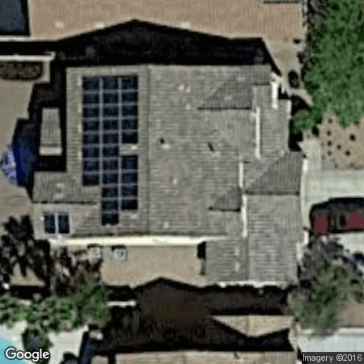
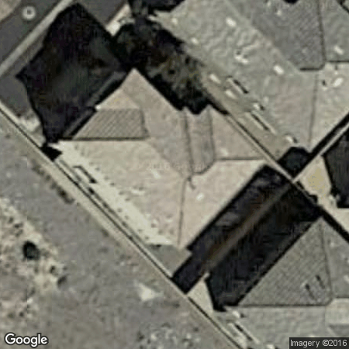


Solar Panel Identification
Project Summary
Goal: Use satellite images to determine whether or not homes have solar panels installed

Slide 4
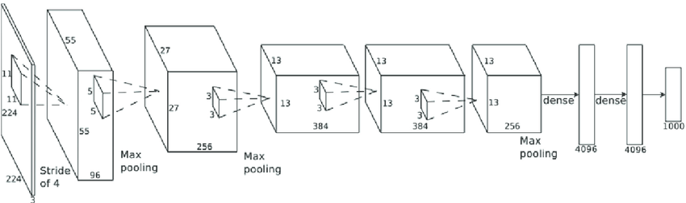
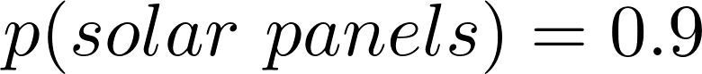
Solar Panel Identification
Project Summary
Goal: Use satellite images to determine whether or not homes have solar panels installed
Will use convolutional neural networks
Source: https://www.researchgate.net/publication/262678168_Comparison_of_Regularization_Methods_for_ImageNet_Classification_with_Deep_Convolutional_Neural_Networks

Slide 5
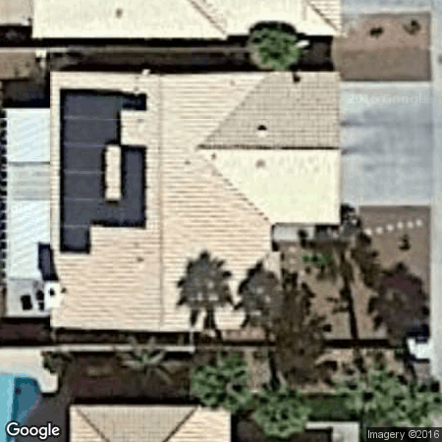
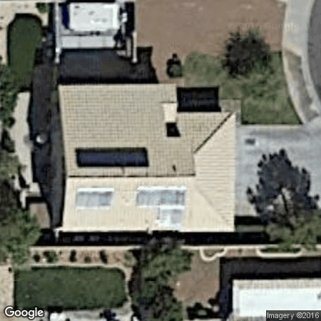
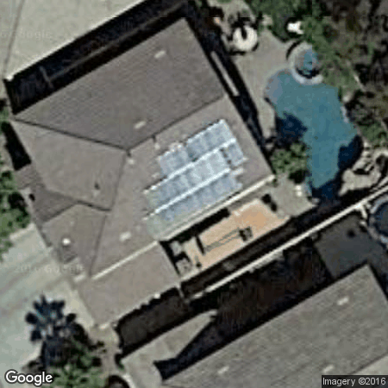
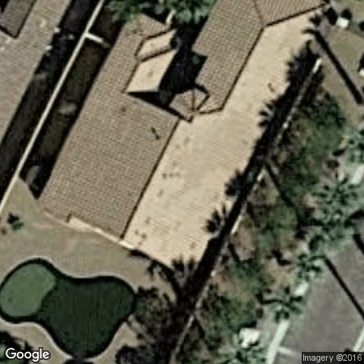
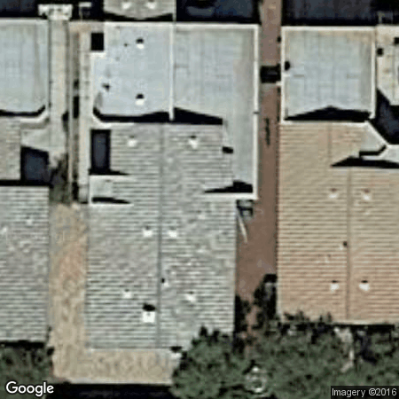
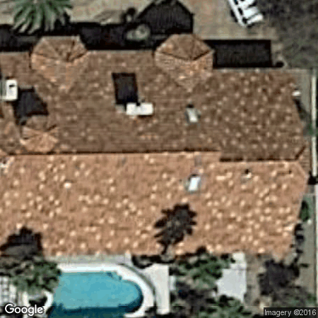
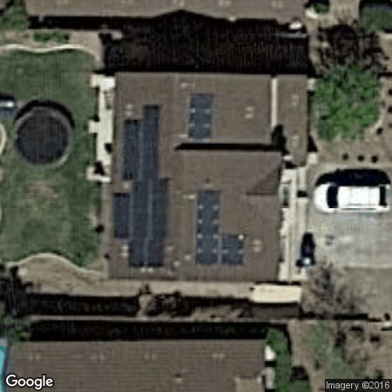
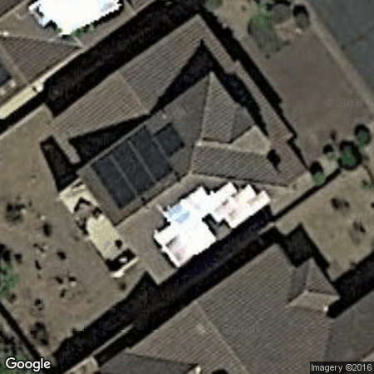
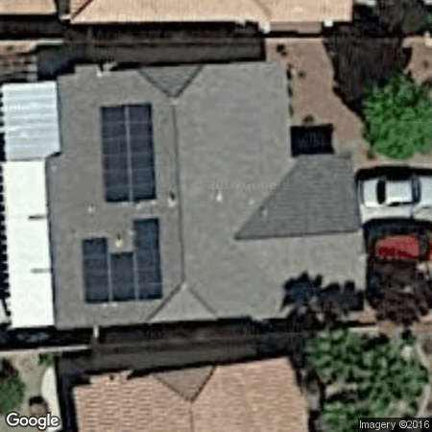
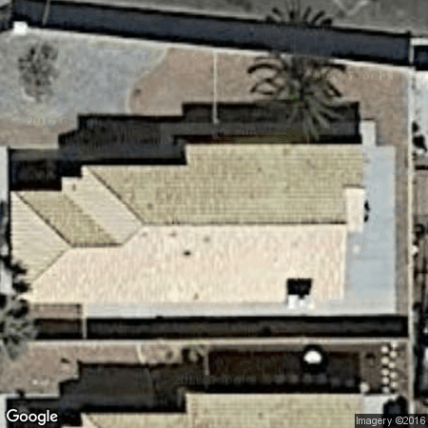
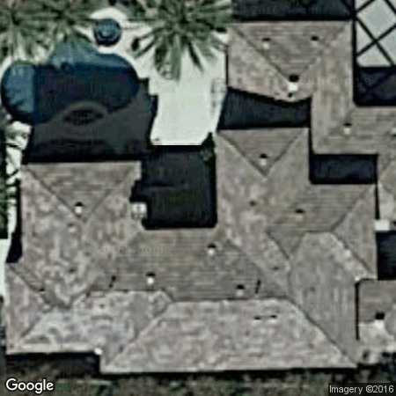
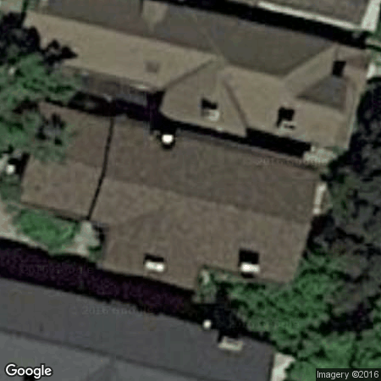
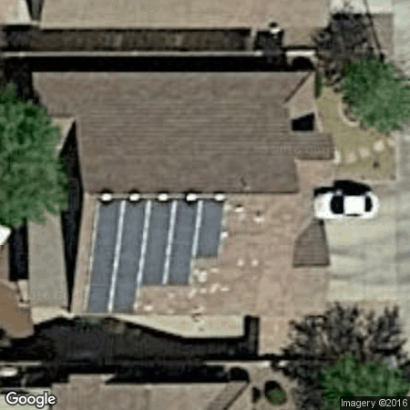
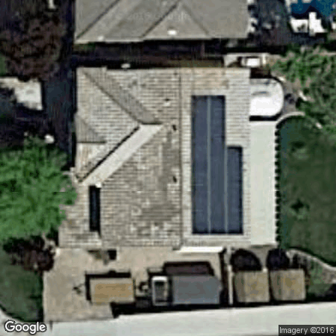
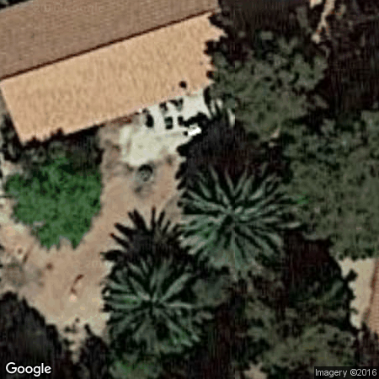
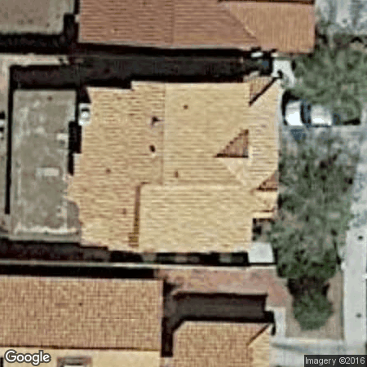
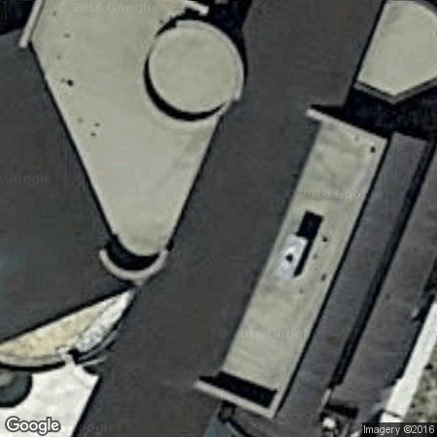
Solar Panel Identification
Project Summary
Goal: Use satellite images to determine whether or not homes have solar panels installed
Will use convolutional neural networks
612 images total - 196 with panels and 416 without

Slide 6
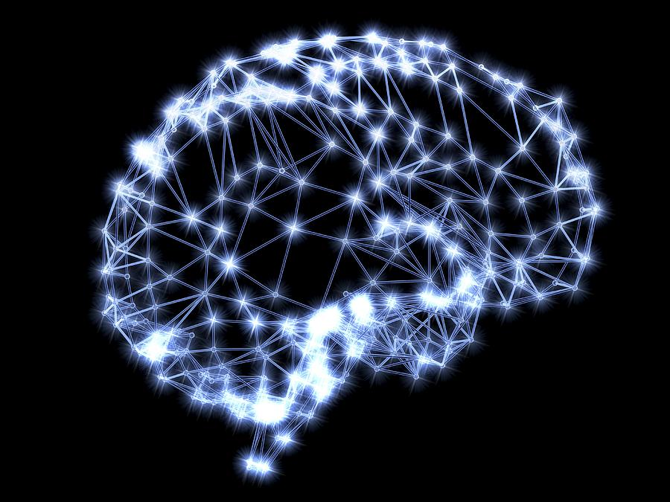

What is a Neural Network?
Introduction to Neural Networks
Neural networks, both biological and artificial, are comprised of interconnected neurons. In both cases the connections between neurons are learned. These connections determine how one neuron firing affects the neurons it is connected to.
Source: http://www-levich.engr.ccny.cuny.edu/webpage/hmakse/
Source: http://cs231n.github.io/neural-networks-1/

Slide 7
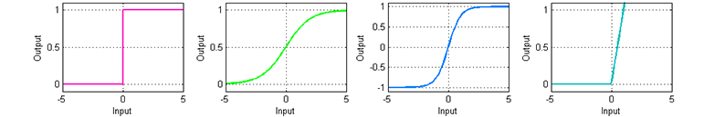
What is a Neural Network?
Introduction to Neural Networks
Neural networks, both biological and artificial, are comprised of interconnected neurons. In both cases the connections between neurons are learned. These connections determine how one neuron firing affects the neurons it is connected to.
Artificial NNs have various activation functions that mimic a neuron “firing”
Source: https://leonardoaraujosantos.gitbooks.io/artificial-inteligence/content/neural_networks.html

Slide 8
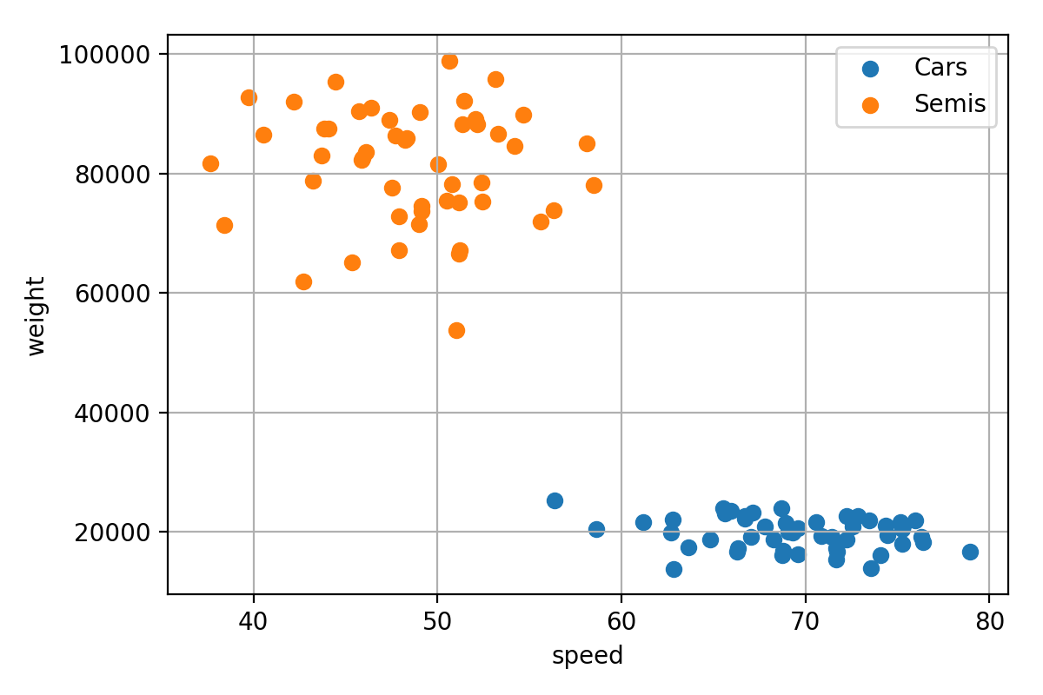
A Basic Example - Logistic Regression
Introduction to Neural Networks
Suppose we want to determine whether a vehicle is a car (0) or semi-truck (1) based on its speed (x1) and weight (x2)

Slide 9
A Basic Example - Logistic Regression
Introduction to Neural Networks
Suppose we want to determine whether a vehicle is a car (0) or semi-truck (1) based on its speed (x1) and weight (x2)
Linear Mapping
(Project onto line)

Slide 10
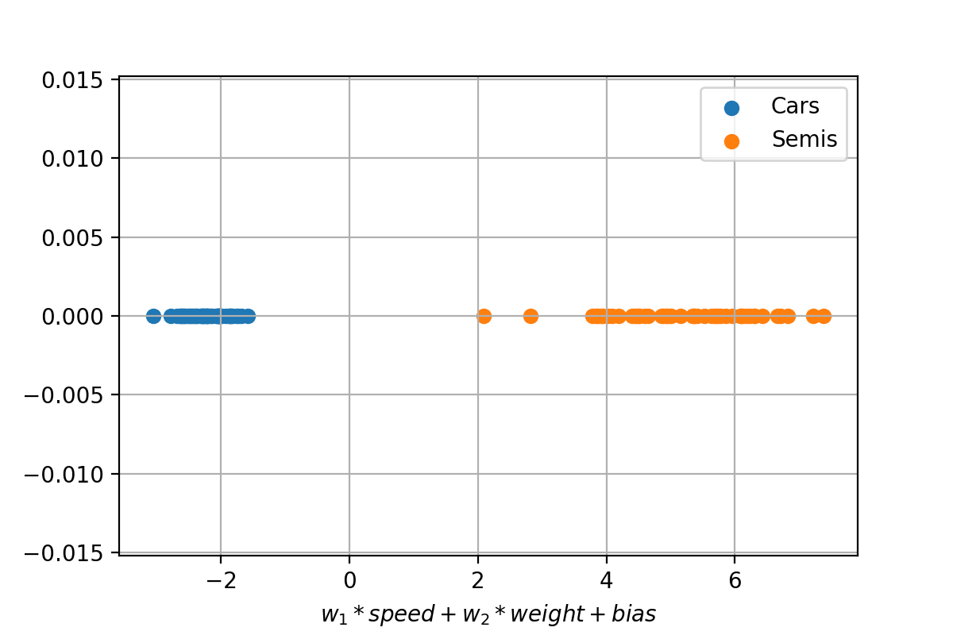
A Basic Example - Logistic Regression
Introduction to Neural Networks
Suppose we want to determine whether a vehicle is a car (0) or semi-truck (1) based on its speed (x1) and weight (x2)
w0 ensures projection centered around 0
w1 and w2 determine the slope of the line

Slide 11
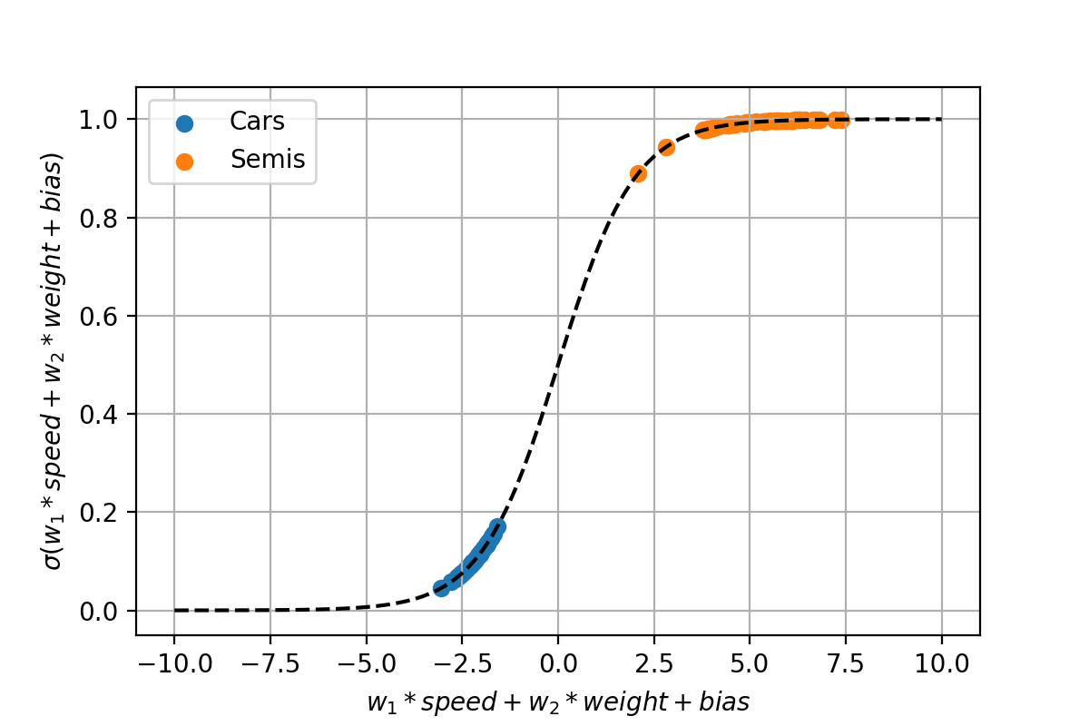
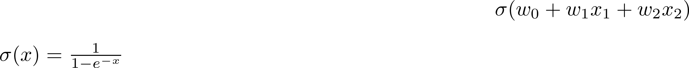
A Basic Example - Logistic Regression
Introduction to Neural Networks
Suppose we want to determine whether a vehicle is a car (0) or semi-truck (1) based on its speed (x1) and weight (x2)
Logistic Regression
(Non-linear map to [0,1])

Slide 12

A Basic Example - Logistic Regression
Introduction to Neural Networks
Suppose we want to determine whether a vehicle is a car (0) or semi-truck (1) based on its speed (x1) and weight (x2)
A one layer neural network!

Slide 13
Why Deep Learning?
Introduction to Neural Networks
We were able to perfectly separate cars and semis, why not use one layer?

Slide 14
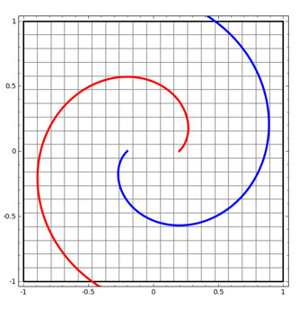
Why Deep Learning?
Introduction to Neural Networks
We were able to perfectly separate cars and semis, why not use one layer?
When we cannot separate by drawing a line, space must be warped non-linearly
By increasing the number of layers, we are increasing the number of ways that space can be transformed to separate the classes
Source: cs231n.github.io/neural-networks-1/http://colah.github.io/posts/2014-03-NN-Manifolds-Topology/

Slide 15
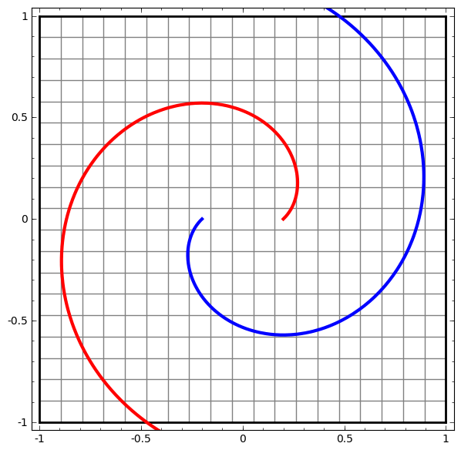
Why Deep Learning?
Introduction to Neural Networks
We were able to perfectly separate cars and semis, why not use one layer?
When we cannot separate by drawing a line, space must be warped non-linearly
By increasing the number of layers, we are increasing the number of ways that space can be transformed to separate the classes
…
Warp 2D space … until you can separate with a line
Source: cs231n.github.io/neural-networks-1/http://colah.github.io/posts/2014-03-NN-Manifolds-Topology/

Slide 16
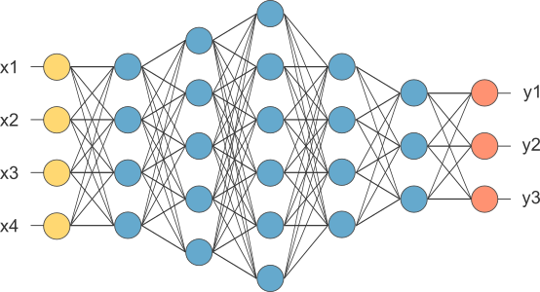
Fully Connected Neural Networks
Introduction to Neural Networks
The simplest type of neural network is a fully connected (or dense) network.
Inputs
(4 features)
Outputs
(3 classes)
Activation functions
selected at each layer
Hidden layers
(5 layers, 3-6 neurons per layer)
Source: opennn.net

Slide 17
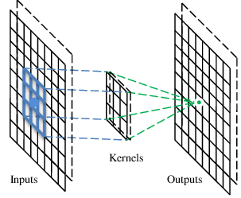
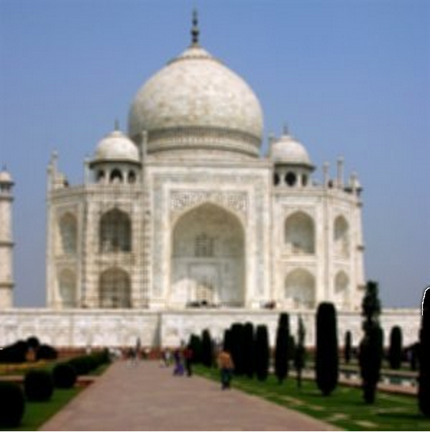

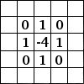
Convolutional Neural Networks
Introduction to Neural Networks
Convolutional neural networks (CNNs) are used when the inputs to the model have a spatial structure that can be leveraged
Pixels of an image that are close to each other are more related than those on opposite sides of the image
For the bikeshare problem, the inputs (weather, day, windspeed, etc.) could be shuffled in any order
Rather than connecting every input to an activation (as in a traditional NN), convolutional layers slide a small kernel across the inputs
The kernel weights are what is learned by training the network – this process is effectively learning the best filters that are used to generate features
The end of the CNN is a usually a traditional fully connected network, used to perform classification on the newly generated features
Example edge detection filter
Source: https://www.researchgate.net/figure/284811415_fig3_Fig-3-The-operation-of-the-convolutional-layer
Source: https://docs.gimp.org/en/plug-in-convmatrix.html

Slide 18
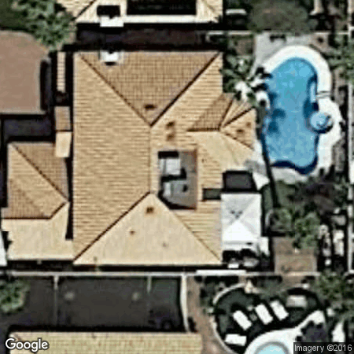
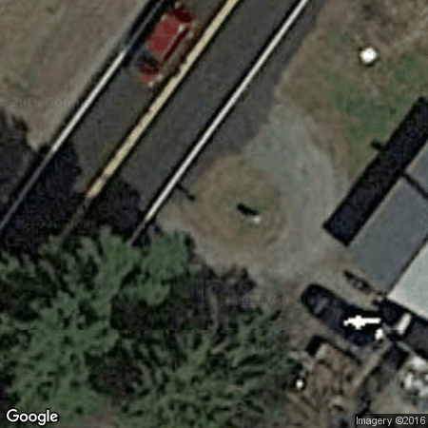
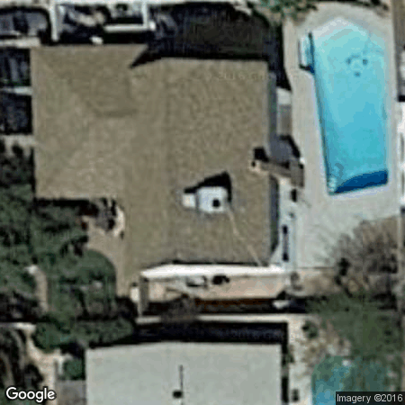
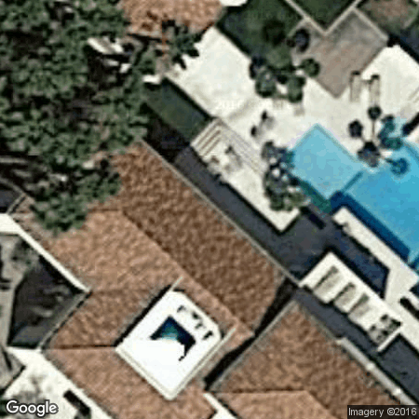
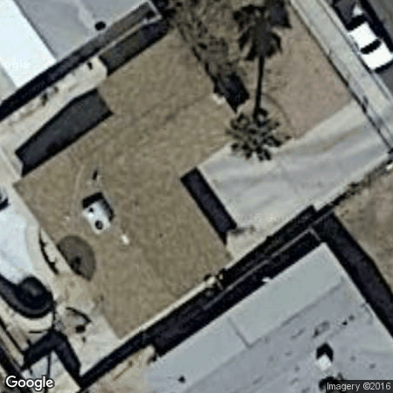
Swimming Pool Classification

Slide 19
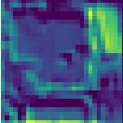
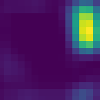
CNN Architecture
Swimming Pool Classification
Convolutional layer C(K,D) – A convolutional layer learns D filters, each one defined by a set of K x K weights that are slid across the input before passing through a nonlinear activation
Max pooling layer M(W) – Downsample by taking the maximum value in each W x W square
Dropout layer D(P) – In each iteration, remove each connection with probability P to prevent overfitting
Fully connected layer F(N) – At the end of the network use fully connected (or dense) layers of N nodes to classify the features generated by the convolutional layers
Regularization R(F) – In order to prevent overfitting, a layer may impose a penalty F on the size of weights
P(pool) = 0.99
8 filters
16 filters
C(3,8)
R(.002)
C(3,8)
R(.002)
M(2)
D(0.25)
C(3,16)
R(.002)
C(3,16)
R(.002)
M(2)
D(0.25)
F(32)
R(.01)
D(0.5)
F(1)
Feature Generation
Classification

Slide 20
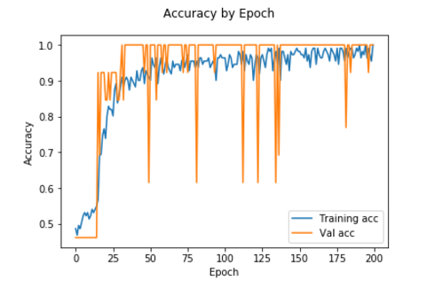
Results
Swimming Pool Classification
Dataset: 186 images, 30 x 30 pixels, 93 pool, 93 no pool
Selected a random 33% for hold out testing (62 images)
During training, used 10% for validation to identify and avoid overfitting
Test Accuracy: 98%
Chance Accuracy: 53%
Pool Samples: 29
No Pool Samples: 33
Misses: 0
False Alarms: 1

Slide 21
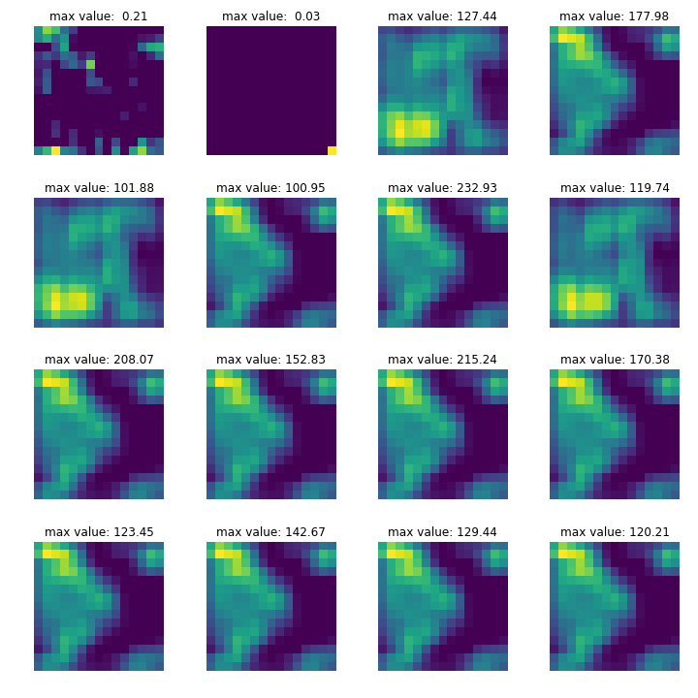
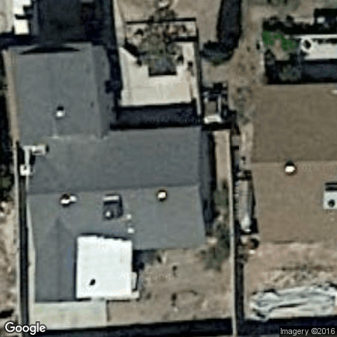
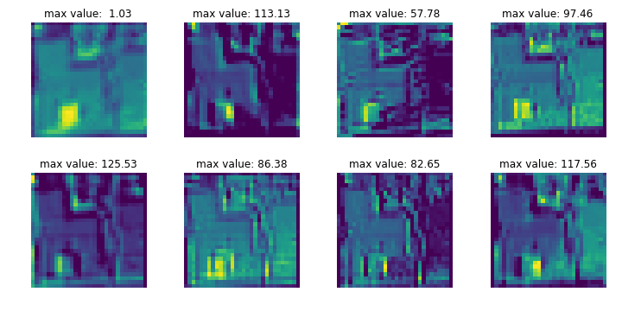
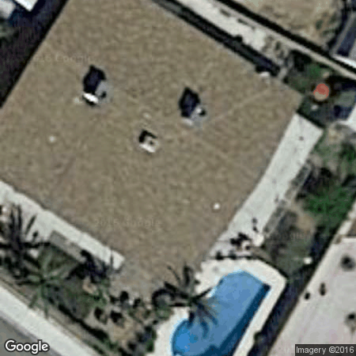
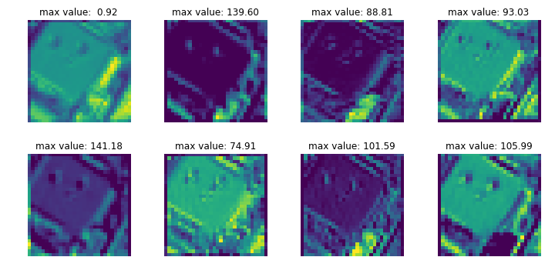
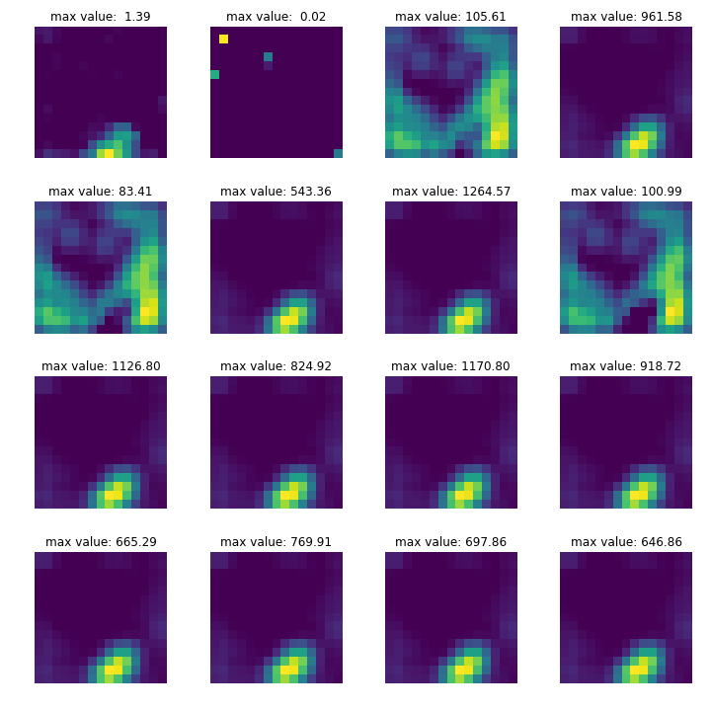
Understanding the Network
Swimming Pool Classification
Inputs
First Conv Layer Outputs
Last Conv Layer Outputs
smoothing
edge detection
Early filters find high-level features
Later filters find differentiating features

Slide 22
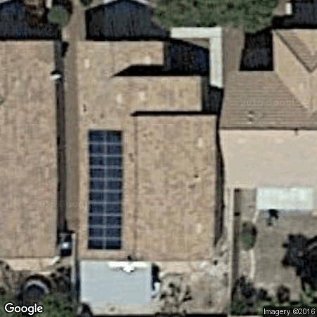
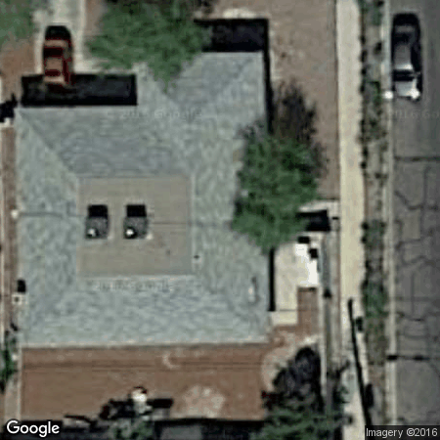
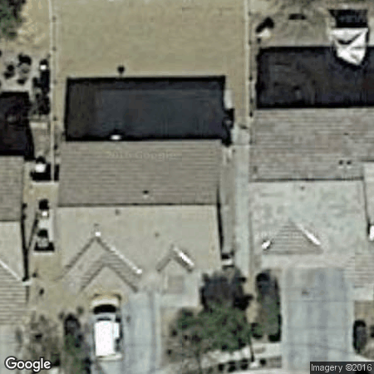
Solar Panel Classification

Slide 23





Challenges
Solar Panel Classification
Solar panels have:
Different shapes
Different colors
Different orientations
Houses without solar panels have:
Shadows
Cars
Neighbors with panels
Our dataset – 196 with solar, 416 without solar:
Very small dataset by CNN standards
Slightly imbalanced data
A more difficult problem necessitates a more complex network, which takes longer to train, which leaves less time to tune parameters

Slide 24



Data Augmentation
Solar Panel Classification
“… build a powerful image classifier, using only very few training examples -- just a few hundred or thousand pictures from each class …” – The Keras Blog
Rotation
Zoom
Horizontal Flip
Vertical Flip
410 training images
Even if the pictures look similar, a $10°$rotation could significantly affect the output of a filter that recognizes corners (for example)
1910 training images

Slide 25



CNN Architecture
Solar Panel Classification
Input – 64 x 64 pixel image
Convolutional layer C(K,D) – Significantly larger kernel and greater depth than pool CNN
Max pooling layer M(W)
Dropout layer D(P)
Fully connected layer F(N) – 16 times more neurons than pool CNN
Regularization R(F) – Greatly reduced regularization from pool CNN
P(solar panel) = 0.99
128 filters
256 filters
C(10,128)
R(.00001)
C(10,128)
R(.00001)
M(2)
D(0.25)
C(10,256)
R(.00001)
C(10,256)
R(.00001)
M(2)
D(0.25)
F(512)
R(.0001)
D(0.5)
F(1)
Feature Generation
Classification

Slide 26
Results
Solar Panel Classification
1910 training images (410 original, 1500 augmented)
1719 used to learn weights
191 used for validation
202 test images (63 solar, 139 no solar)
Training Accuracy – Approaching perfect (with 0 loss)
Validation Accuracy – Approaching perfect (with non-zero loss)
Testing Results
Accuracy – 90%
Chance Accuracy – 68%
Missed – 11 out of 63
False Alarms – 9 out of 139

Slide 27
Understanding the Network
Solar Panel Classification
Understanding the network is tough…
512 filters at the last conv layer
Not as simple as having a solar panel filter (unlike a blue filter)
Features get combined in complex ways in the fully connected layer
We’ll look at two hold out test samples where the network classifies solar with high confidence

Slide 28

Understanding the Network
Solar Panel Classification

Slide 29



Understanding the Network
Solar Panel Classification

Slide 30

What Did the Trick?
Solar Panel Classification
At the time of the Hackathon presentation, the solar model was not working, so what changed?
In experimenting with different parameters, I could never get the validation performance to improve throughout training
It was likely a combination of modifications, but the final modification that yielded results was increasing kernel size
3 x 3 Kernel
can only capture local features – panel and shadow look the same
10 x 10 Kernel
captures context and larger patterns in the shape.

Slide 31

Technical Details
(or, how to create an effective model in less than 7 million internships)

Slide 32
Python/Jupyter/Keras – CNN in 6 Cells
Technical Details
Load the data
Imports
Specify desired shape, initialize image array and create labels
Load from solar panel directory
Load from no solar directory
import os
import numpy as np
from skimage import io
from scipy.misc import imresize, imsave
shape = (64,64,3)
X = np.zeros((num_samples,)+shape)
y = np.zeros((num_samples,))
y[:num_pool_samples] = 1
index = 0
for (_, _, filenames) in os.walk('../data/with panels'):
for f in filenames:
# load the image as numpy array
im = io.imread('../data/with panels/' + f)
# resize image to desired shape
im_resize = imresize(im,shape)
# store in data matrix
X[index,:,:,:] = im_resize
index += 1
for (_, _, filenames) in os.walk('../data/without panels'):
for f in filenames:
im = io.imread('../data/without panels/' + f)
im_resize = imresize(im,shape)
X[index,:,:,:] = im_resize
index += 1

Slide 33
Python/Jupyter/Keras – CNN in 6 Cells
Technical Details
Load the data
Split into train/test
Imports
Split data
Save relevant details
Ensure correct type and normalize
from sklearn.model_selection import train_test_split
X_train, X_test, y_train, y_test = train_test_split(X, y,
test_size=0.33,random_state=4)
num_train, height, width, depth = X_train.shape
num_test = X_test.shape[0]
X_train = X_train.astype('float32')
X_test = X_test.astype('float32')
X_train /= np.max(X_train)
X_test /= np.max(X_test)

Slide 34
Python/Jupyter/Keras – CNN in 6 Cells
Technical Details
Load the data
Split into train/test
Set parameters
batch_size = 5
num_epochs = 100
kernel_size = 10
pool_size = 2
conv_depth_1 = 128
conv_depth_2 = 256
drop_prob_1 = 0.25
drop_prob_2 = 0.5
hidden_size = 512
conv_reg = 0.0001
hidden_reg = 0.0001
learning_rate = 0.0001

Slide 35
Python/Jupyter/Keras – CNN in 6 Cells
Technical Details
from keras.models import Model,load_model
from keras.layers import Input, Convolution2D, MaxPooling2D
from keras.layers import Dense, Dropout, Flatten
from keras.utils import
from keras.optimizers import RMSprop
from keras import regularizers
inp = Input(shape=(height, width, depth))
conv_1 = Convolution2D(conv_depth_1, (kernel_size, kernel_size),
kernel_regularizer=regularizers.l2(conv_reg),
padding='same', activation='relu')(inp)
conv_2 = Convolution2D(conv_depth_1, (kernel_size, kernel_size),
kernel_regularizer=regularizers.l2(conv_reg),
padding='same', activation='relu')(conv_1)
pool_1 = MaxPooling2D(pool_size=(pool_size, pool_size))(conv_2)
drop_1 = Dropout(drop_prob_1)(pool_1)
conv_3 = Convolution2D(conv_depth_2, (kernel_size, kernel_size),
kernel_regularizer=regularizers.l2(conv_reg),
padding='same', activation='relu')(drop_1)
conv_4 = Convolution2D(conv_depth_2, (kernel_size, kernel_size),
kernel_regularizer=regularizers.l2(conv_reg),
padding='same', activation='relu')(conv_3)
pool_2 = MaxPooling2D(pool_size=(pool_size, pool_size))(conv_4)
drop_2 = Dropout(drop_prob_1)(pool_2)
flat = Flatten()(drop_2)
hidden1 = Dense(hidden_size,activation='relu',
kernel_regularizer=regularizers.l2(hidden_reg))(flat)
drop_3 = Dropout(drop_prob_2)(hidden1)
out = Dense(1, activation='sigmoid')(drop_3)
model = Model(inputs=inp, outputs=out)
rms_prop = RMSprop(lr=learning_rate)
model.compile(loss='binary_crossentropy',optimizer=rms_prop,
metrics=['accuracy'])
Load the data
Split into train/test
Set parameters
Compile the model
Imports
Create all the layers
Specify a model
Specify the optimization technique and compile the model

Slide 36
Python/Jupyter/Keras – CNN in 6 Cells
Technical Details
Load the data
Split into train/test
Set parameters
Compile the model
Train the model
Train the model
Plot the accuracy
fit_results = model.fit(X_train, y_train, batch_size=batch_size, epochs=10,
verbose=1, validation_split=0.15, class_weight={0:1,1:1})
plt.plot(fit_results.history['acc'], label='Training acc')
plt.plot(fit_results.history['val_acc'], label='Val acc')
plt.legend()
plt.ylabel("Accuracy")
plt.xlabel("Epoch")
plt.suptitle("Accuracy by Epoch")
plt.show()

Slide 37
Python/Jupyter/Keras – CNN in 6 Cells
Technical Details
Load the data
Split into train/test
Set parameters
Compile the model
Train the model
Test the model
Predict based on training data (probabilities)
Compare to threshold to get binary class estimates and convert from bool to int
Print results from testing
y_hat = model.predict(X_test)
labels = (y_hat > 0.5)
y_hat = [label[0] for label in labels.astype(int)]
print("Test Accuracy: %f"%(float(sum(y_hat == y_test))/len(y_hat)))
print("Chance Accuracy: %f"%(1-float(sum(y_test))/len(y_hat)))
print("Solar Examples:%i"%sum(y_test == 1))
print("Misses:%i"%sum(y_hat - y_test == -1))
print("No Solar Examples:%i"%sum(y_test == 0))
print("False Alarms:%i"%sum(y_hat - y_test == 1))

Slide 38
Parameter Tuning
Technical Details
“There are no clear cut rules to choosing the right parameters” – Every blog/message board on neural networks
Most changes should be made based on training results – how do the training loss and validation loss progress?
Training loss never decreases – Model needs more complexity. Add layers, add depth, make kernel bigger, increase resolution.
Training loss decreases, validation loss does not (at all) – Model is unable to generalize at all. May need more samples if model is able to 100% overfit.
Training loss decreases, validation loss decreases to a point before increasing – Model is overfitting, but generalizing some. Use regularization to reduce ability of model to overfit to training data and/or use more samples.
Training and validation loss decrease, but not monotonically in later epochs – Gradient steps are too big. Decrease the learning rate and continue training.
Keep in mind – the kernel size and image resolution are closely related. A 5x5 kernel in a downsized image can capture larger scale features in a downsized image than in a full size image

Slide 39
Tips & Tricks – Saving Models
Technical Details
As the models get bigger, it takes longer to run. You may want to run in the background and monitor over time.
Running in verbose mode can crowd the notebook and freeze it. Only print every N epochs, saving the model each time so you can evaluate the model in another notebook.
model_num = 8
for i in range(200):
fit_results = model.fit(X_train, y_train, batch_size=3, epochs=1, verbose=0, validation_split=0.1,class_weight={0:1,1:2})
if(i%5==0):
print('Saving Epoch %i'%i)
print('Training Loss: %f'%fit_results.history['loss'][0])
print('Validation Loss: %f'%fit_results.history['val_loss'][0])
print('Training Accuracy: %f'%fit_results.history['acc'][0])
print('Validation Accuracy: %f'%fit_results.history['val_acc'][0])
model.save('../models/solar_model_%i_epoch%i.h5'%(model_num,i))
Notebook 1
Notebook 2
from keras.models import load_model
model = load_model(‘../models/solar_model_8_epoch360.h5’)

Slide 40
Tips & Tricks – Intermediate Layer Models
Technical Details
Looking at the outputs of intermediate layers is helpful to (1) understand how the network works, and (2) verify that the network is doing what we want it to
If the pool network is not having a lot of activation around the pool, then we’ve got some issues…
layer_num = 1
intermediate_layer_model = Model(inputs=model.input, outputs=model.layers[layer_num].output)
sample_index = 30
sample = X_test[sample_index,:,:,:]
output = intermediate_layer_model.predict(np.expand_dims(sample,axis=0))
filter_num = 5
plt.imshow(np.squeeze(output,axis=0)[:,:,filter_num])
plt.show()

Slide 41
Tips & Tricks – Augmenting Data
Technical Details
ONLY AUGMENT TRAINING DATA
If using the built in method for holding out a validation set on training, be prepared for the validation accuracy to be higher than test accuracy
Imports
Create data generator with desired parameters
Generate a new image for each of the training images a desired number of times
Append augmented training data to original training data
from keras.preprocessing.image import ImageDataGenerator
datagen = ImageDataGenerator(
featurewise_center=False,
samplewise_center=False,
featurewise_std_normalization=False,
samplewise_std_normalization=False,
rotation_range=10.,
width_shift_range=0.,
height_shift_range=0.,
shear_range=0.,
zoom_range=0.1,
channel_shift_range=0.,
fill_mode='nearest',
cval=0.,
horizontal_flip=True,
vertical_flip=True,
rescale=None,
preprocessing_function=None)
from keras.preprocessing.image import ImageDataGenerator, array_to_img, img_to_array, load_img
augmented_data = np.zeros((0,) + shape)
augmented_labels = np.asarray([])
factor_increase = 5
i = 0
for batch_data,batch_labels in datagen.flow(X_train, y_train, batch_size=X_train.shape[0]):
augmented_data = np.vstack((augmented_data,batch_data))
augmented_labels = np.append(augmented_labels,batch_labels)
if i == factor_increase:
break
i += 1
X_aug_train = np.vstack((X_train,augmented_data))
y_aug_train = np.append(y_train,augmented_labels)

Slide 42
What Next?
Technical Details
Different activation units
Re-augment data after each epoch
More (un-augmented) data
Increasingly smaller step size and more epochs
Multiple fold cross validation
Larger kernel size and larger resolution (same coverage of kernel but with higher resolution)
Pair with roof identifying model
Pretrained networks
The list goes on…

Slide 43

Bonus Example – Logistic Regression Ensemble
Technical Details
Gaussians
centered at
(10,10)
(5,5)
(0,0)
Clearly there is no line that separates orange and blue.
Therefore, logistic regression is not sufficient!

Slide 44
Bonus Example – Logistic Regression Ensemble
Technical Details
We can consider multiple lines and note that
1) Each orange dot appears in an orange circle
2) Blue dots always appear in blue circles
Formalize this by creating two logistic regressions

Slide 45




Bonus Example – Logistic Regression Ensemble
Technical Details
The first logistic regression creates space between (0,0) cluster and blue
The second logistic regression creates space between (10,10) cluster and blue

Slide 46

Bonus Example – Logistic Regression Ensemble
Technical Details
Using the output of each logistic regression as a dimension in a new 2-dimensional space, we can now separate with a line (an additional logistic regression)

Slide 47
Bonus Example – Logistic Regression Ensemble
Technical Details
What does this have to do with neural networks?
Using the output of each logistic regression as a dimension in a new 2-dimensional space, we can now separate with a line (an additional logistic regression)

Slide 48






Bonus Example – Logistic Regression Ensemble
Technical Details
Recall: Logistic regression can be thought of as a 1-layer neural network
1
1

Slide 49

Bonus Example – Logistic Regression Ensemble
Technical Details
If we combine them and add an output layer, we now have a hidden layer!
1
1
Points in warped 2-D space can now be linearly separated
Output layer achieves separation between ALL blue and orange points

